Slide 1
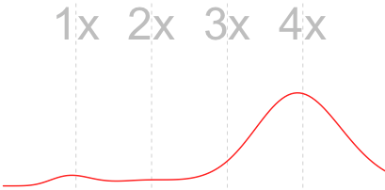

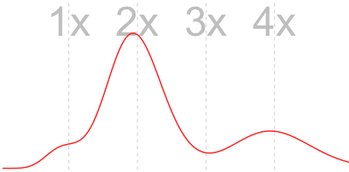
Allo or auto
Or: “What do I expect my k-mer spectrum to look like?”
Hannes Becher, University of Edinburgh
GitHub: https://github.com/hannesbecher
Twitter: https://twitter.com/hannes_becher
Web: http://bryoevolgen.com
Email: hbecher[at]ed.ac.uk

Slide 2
Outline
Types of tetraploids
From popgen to k-mer spectra
Fitting parameters (the interactive Tetmer app)
Summary

Slide 3
Types of tetraploids
Autotetraploids: four homologous genomes
Allotetraploids:
  two pairs of homologous genomes
  pairs homeologous to each other
They have different k-mer spectra
Characterisation of k-mer spectra – frequency of “block” types:
  abbb
  aabb
  abcc
Block-wise SFS machinery developed by Konrad Lohse: Lohse et al. (2011, 2016) Genetics
Notes:
Schematic from previous talk with chromosomes and branches
One example spectrum each, allo vs auto
Straightforwar to tell from looking at spectrum, but what exactly do we expect?

Slide 4
Genetic models of k-mer spectra
A panmictic (well-mixed, ideal) population
of diploids:
Block type frequencies depend on population parameters:
  θ (θ)
    Genetic diversity in a population
    θ = 4 * effective popsize * mutation rate (θ >= 0)
    In a diploid, proportion of k-mer sites that are different between the genomes
Each individual’s heterozygosity reflects the whole population’s genetic diversity.
Notes:
Theta is a population’s genetic diversity, pairwise differences
Can be done on nucleotide level (pi), we use it on kmer level.
In apanmictic population theta = heterozygosity
In a panmictiv population, it does not matter which individual (or which two genomes) we look at. All have same level of heterozygosity (but at different sites).
Tehta is relate to population size. All else being equal, a large pop with have higher theta and higher heterozygosity. You know what that means for a diploid individual’s k-mer spectrum.
If we look at more than two genomes at a time, there will be more variant sites than in a diploid. Also there are different kinds of variant sites (or better blocks) possible.
Theta is >= 0

Slide 5
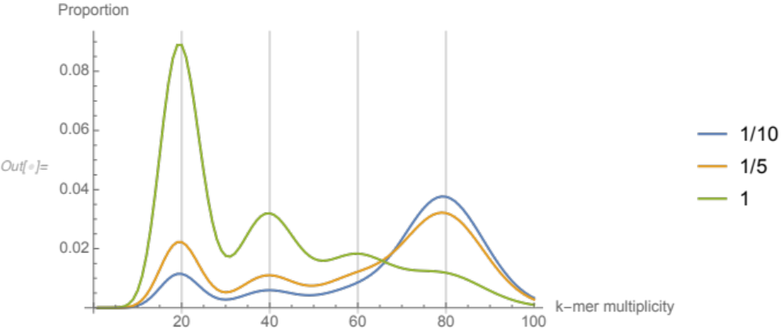
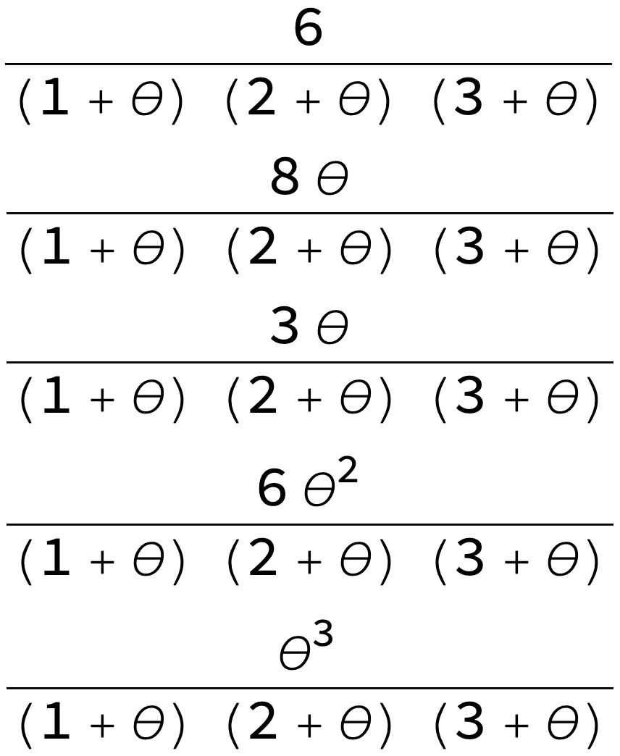



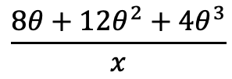






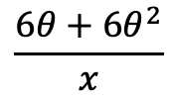


Genetic models of k-mer spectra
1
1
1
2
2
1
4
$$\left(1+θ\right)\left(2+θ\right)\left(3+θ\right)=x$$
$$\frac{8θ+12θ^{2}+4θ^{3}}{x}$$
$$\frac{8θ}{x}$$
$$\frac{6θ+6θ^{2}}{x}$$
$$\frac{6}{x}$$
Notes:
four terms, one for each peak. And they can be turned into a k-mer spectrum...
All have the same denominator
1st peak always more k-mers than 2nd
And 3rd

Slide 6
Genetic models of k-mer spectra
Block type frequencies depend on population parameters:
  θ (θ)
    Genetic diversity in a population
    θ = 4 * effective popsize * mutation rate (θ >= 0)
    In a diploid, proportion of k-mer sites that are different between the genomes
  T (in allopolyploids)
    Sub-genome divergence
    Time measured in generations
    Scaled by the effective population size
Notes:
Konrad, Gertjan
Genetating fiunction for frequencies of block types
two populations or two classes of genomes in an allopolyploid

Slide 7
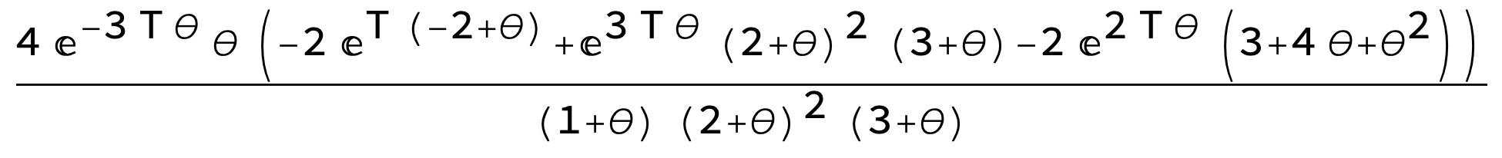
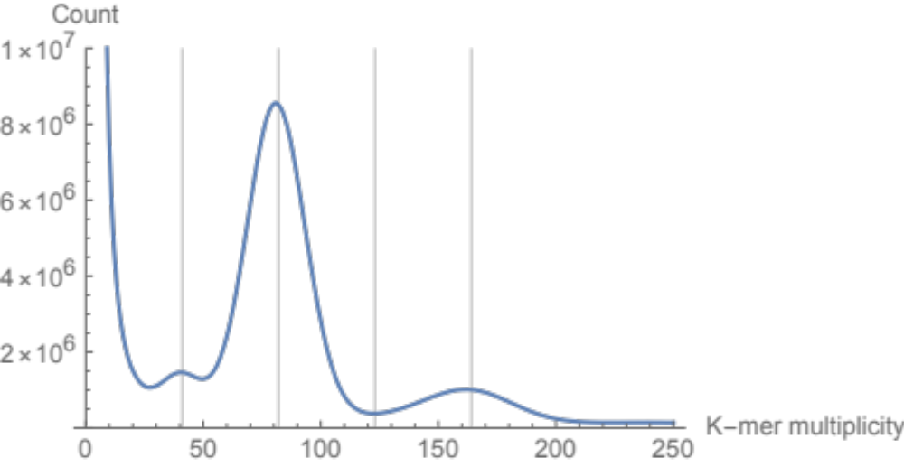
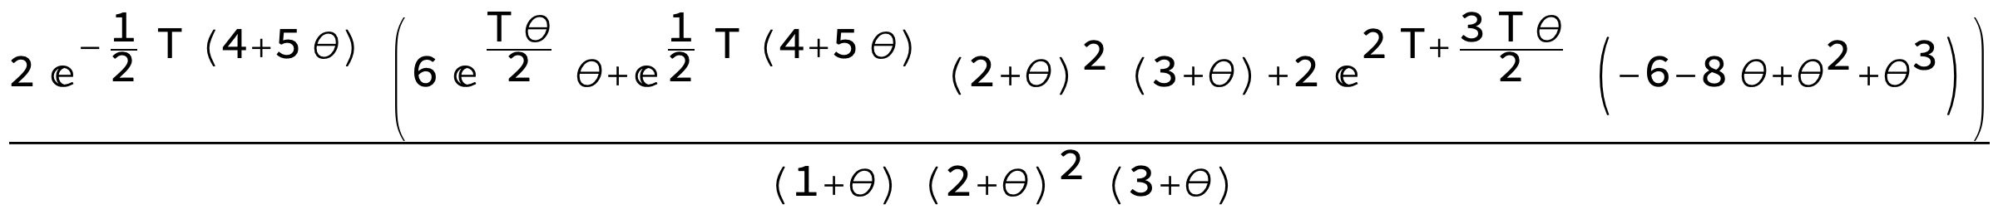
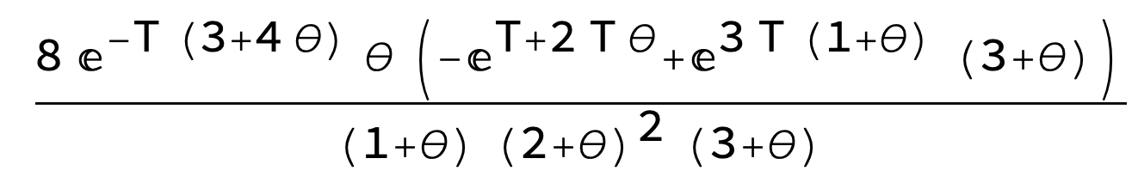
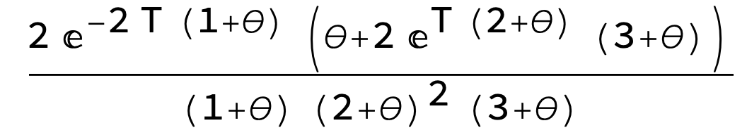
From parameters to block type frequencies
Notes:
So, Tetmer not only helps you to decide is is allo or auto, also fits genetic parameters
Theta (per k-mer), divergence time in allo.
But this only works if there is no population structure.

Slide 8
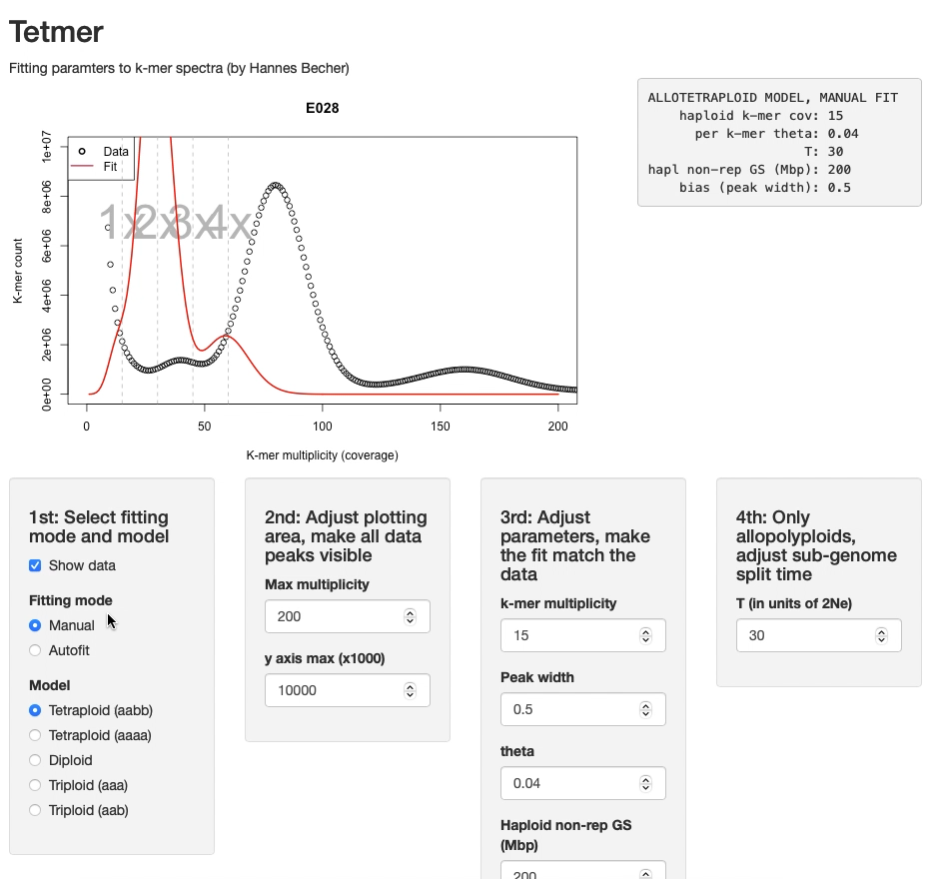
Inferring pop parameters from spectra
We know how a spectrum’s shape depends on:
  θ (genetic diversity) and
  T (divergence time of sub-genomes).
We can thus infer these parameters from spectra.
That’s what Tetmer does!
Notes:
Tetmer is interactive

Slide 9
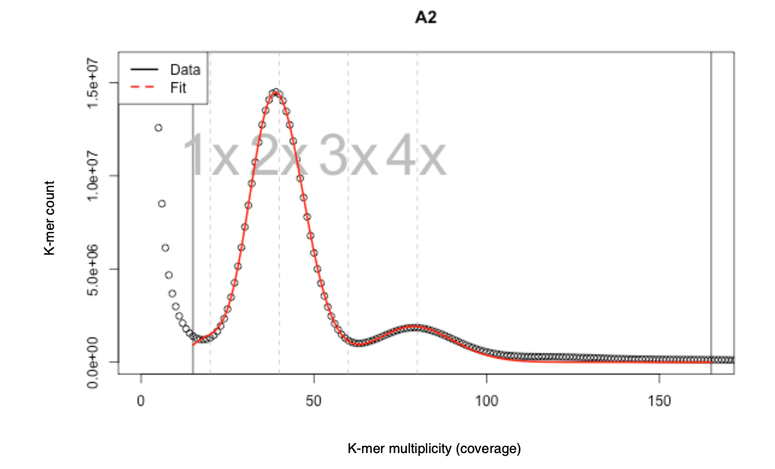
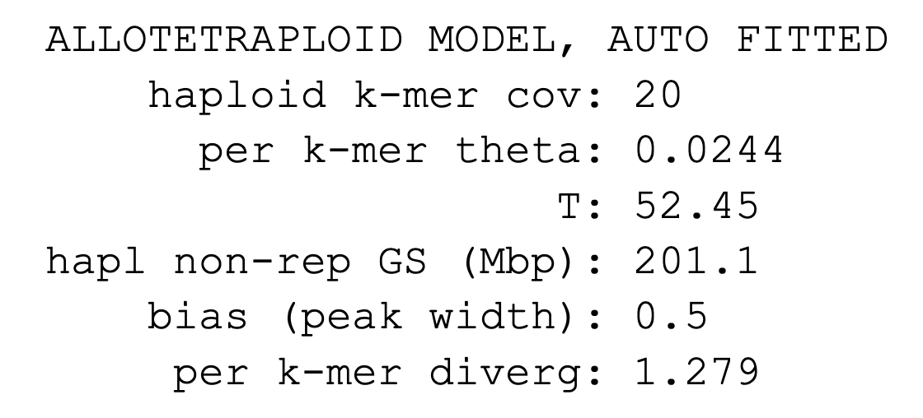
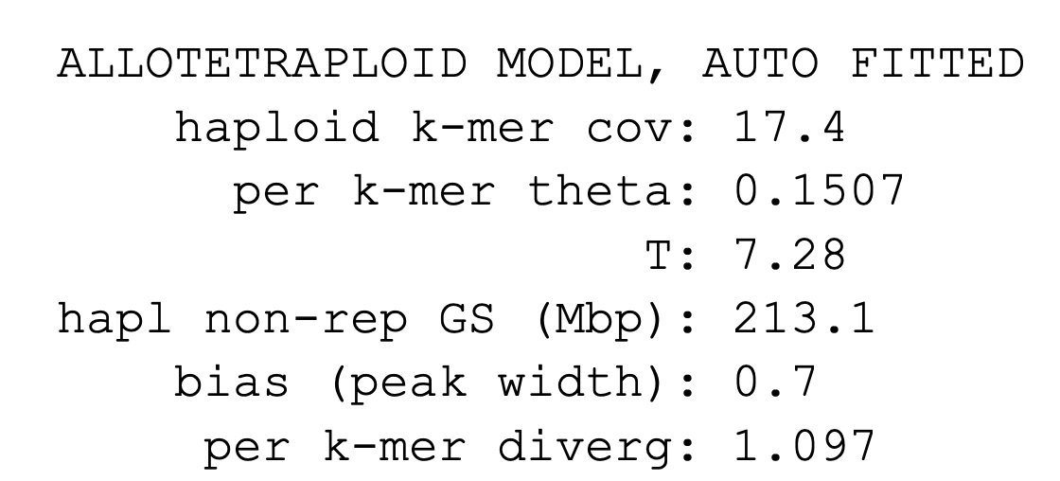
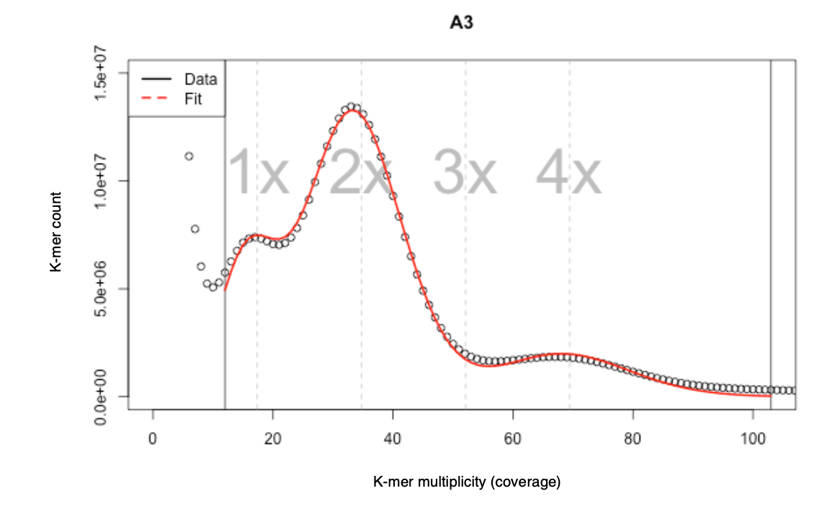
Models and reality
Two spectra of the same species, both samples from the same small island:
These model assumed well-mixed populations (no population structure)
Commonly violated due to:
  Selfing
  Assortative mating
  Geographic structure
The effective population size depends on θ. It is much higher in the second plot. -> T is estimated lower.
Sub-genome divergence is more robust.
low θ
high θ

Slide 10
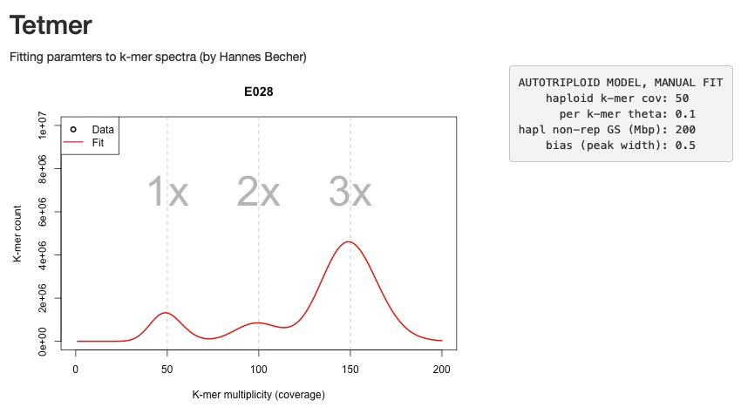
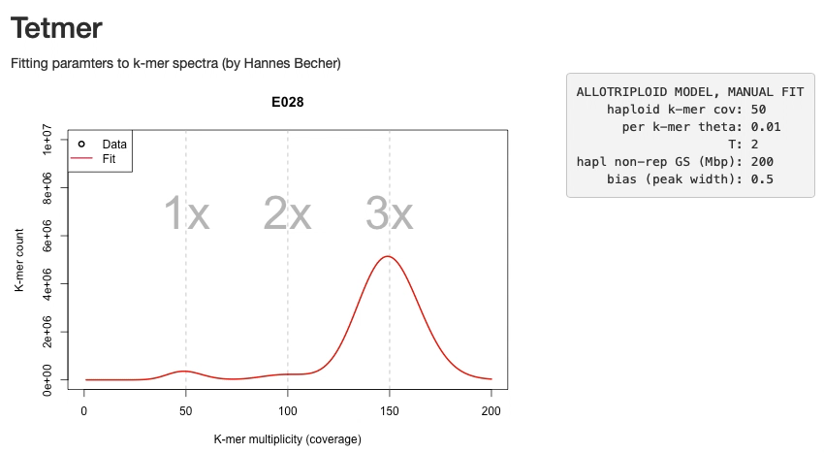
New feature: Triploids

Slide 11
Summary
Very different k-mer spectra in auto- vs allopolyploids
Tetmer fits population parameters to spectra
Ideally 1x peak is clearly visible
In allopolyploids, genetic structure may bias T – sub-genome divergence (T*θ) is more robust.
Tetmer:
https://github.com/hannesbecher/shiny-k-mers
Feedback please:
https://twitter.com/hannes_becher
http://bryoevolgen.com
hbecher[at]ed.ac.uk

